Slide 1




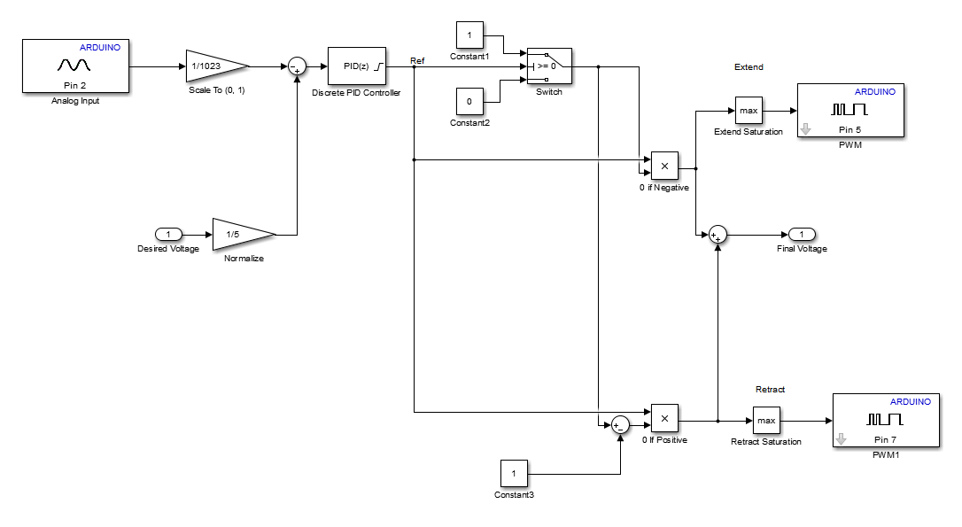
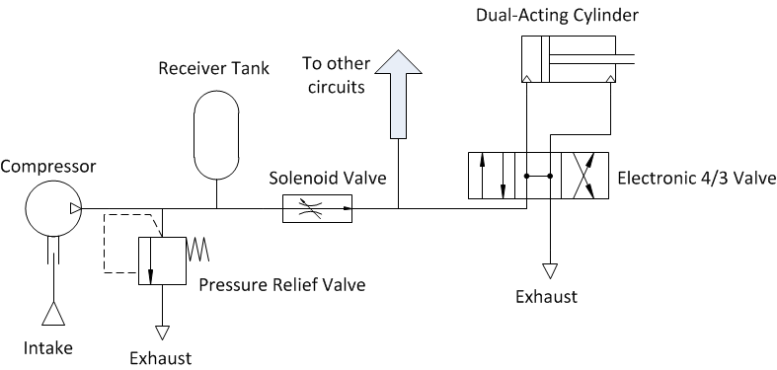
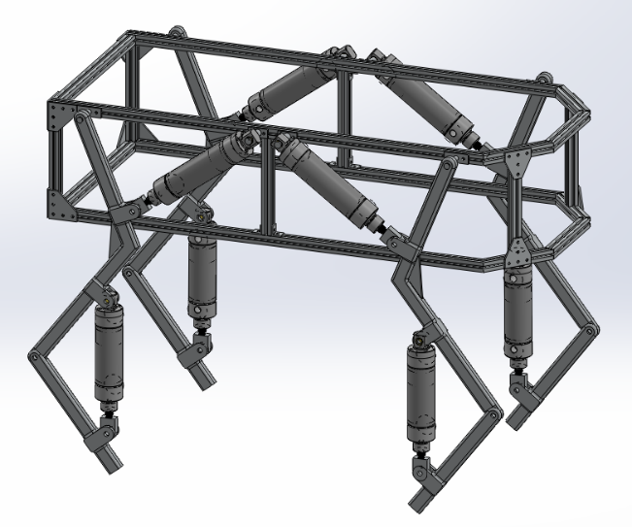
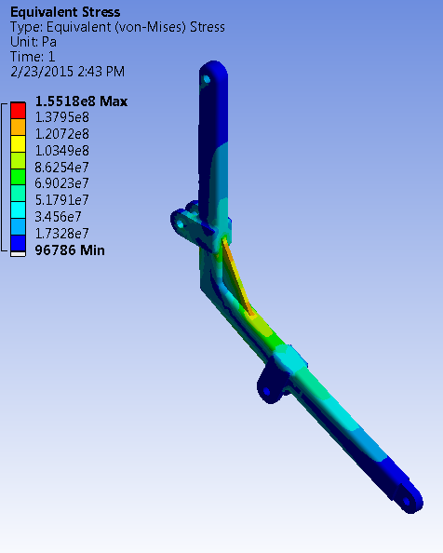
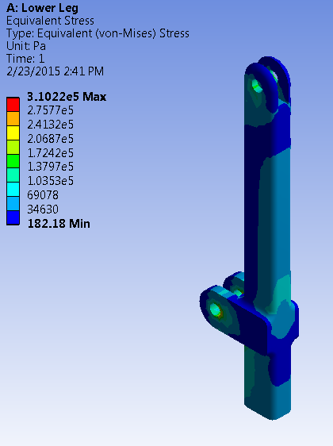
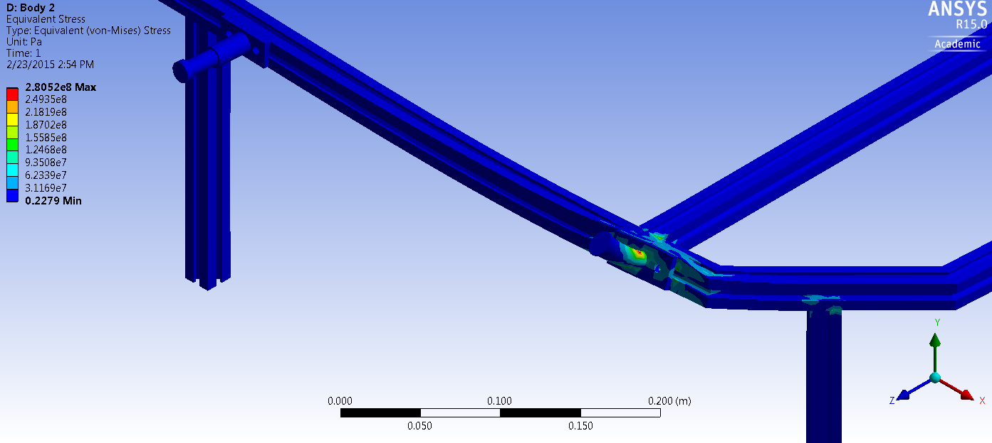
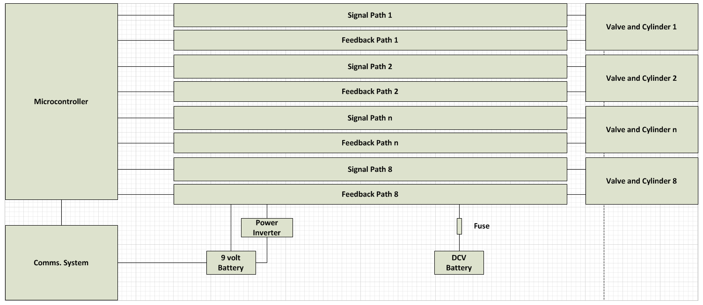
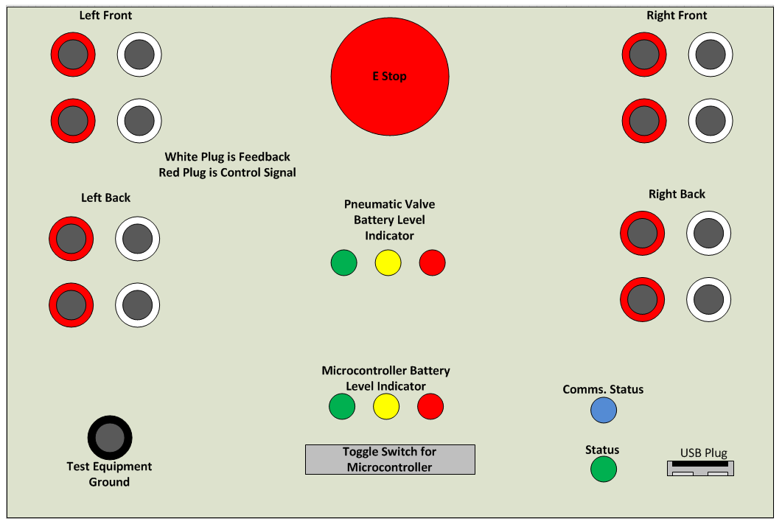
Development of an Agile Pneumatic Educational Robot
Team A.R.C. : Logan Beaver, Justin Campbell, Tyler Paddock, and Ronald Shipman
Advisor: Dr. Luis A. Rodriguez
Spring, 2015
Problem Statement
Recently there has been a decline in interest and proficiency related to science, technology, engineering, and mathematics (STEM) fields. According to a 2013 (WHERE was it done???) survey 46% of all teenagers showed interest in pursuing a STEM or medical related career, which was a 15% decrease from previous years. In addition there is a huge deficit of fluid power engineers in the United States, with only 1% of universities with engineering programs teaching a fluid power concentration. It has also been shown by a study conducted by the University of Nebraska that introducing students to topics in robotics not only improves their attitude towards STEM topics, but also increased their self-efficacy of topics within robotics.
Leg Gait Motion Planning
User Control and Robot Communication
User input is read by a USB controller
Real time Java application parses user input
Application sends commands through an Xbee wireless chip
Partner Xbee chip receives the command and sends it to the Arduino
Arduino decodes the serial command and adjusts the robot state accordingly
Objective
To address the forth mentioned challenges an educational robot platform was developed to increase student interests in STEM fields, fluid power, and robotics through outreach opportunities, laboratory and research experiences.
Design Criteria and Constraints
A maximum weight of 35 kg for portability
Speed ?
Maximum size of 0.75 m x 0.75 m x 1.0 m box for portability
Custom debug panel creation to facilitate troubleshooting
MATLAB and Simulink model support to allow mechanical engineering students to update control algorithms without knowledge of C/C++
Electronic fuses and shielding to protect the robot and operator during use and maintenance
Mechanical protection to reduce the risk of pinching and self-collision damage to the robot
An easy to access emergency stop to quickly depower the robot
A pressure relief valve to reduce the risk of overloading and damaging pneumatic components
Divide into electrical and mechanical
Arduino Mega 2560
XBee
XBee
High Level System Communication Diagram
Leg Pneumatic Circuit
Using pneumatic systems as the driving force for the legs, the following components will be utilized:
Double-acting, air cylinders with position feedback sensors (1.5 in. bore diameter)
Two-solenoid 4 way 3 position directional control valves (0.37 C_{v})
Air-compressor
Pressure relief valve
Soft start/dump solenoid valve
Secondary receiver tank
Control Architecture for the Two-Link Leg
Mathworks Simulink model is loaded onto the Arduino
Utilizes PID feedback loops to control cylinder lengths
Desired length is calculated by a state machine based on user input and current length
Mechanical Design of Chassis
Needs more explaining. Why 6105-T5 slotted aluminum? Light weight, etc.
What are the maximum stresses from the FEA analysis
Chassis Construction
6105-T5 T-Slotted Aluminum Framing (Yield Strength = 275 Mpa)
6061 Aluminum Plate (Yield Strength = 276 Mpa)
Leg Construction
6061 Aluminum Bar (Yield Strength = 276 Mpa)
PID Control subsystem for a single cylinder
Results
Add Figure numbers and Captions to all figures
Conclusion
Future Work
If there is room
Poster Needs Color . It looks very boring
Electrical Design
The debug panel is not as important. I would like to see more details about the motherboard and other electrical schematics. Electrical Part is really underdeveloped
Acknowledgements
Special thanks to the National Fluid Power Association, Otto J. Maha Endowment Fund, Joy Global, Inc., Emerson , MSOE, and Dr. Luis A. Rodriguez for their support

